Slide 1
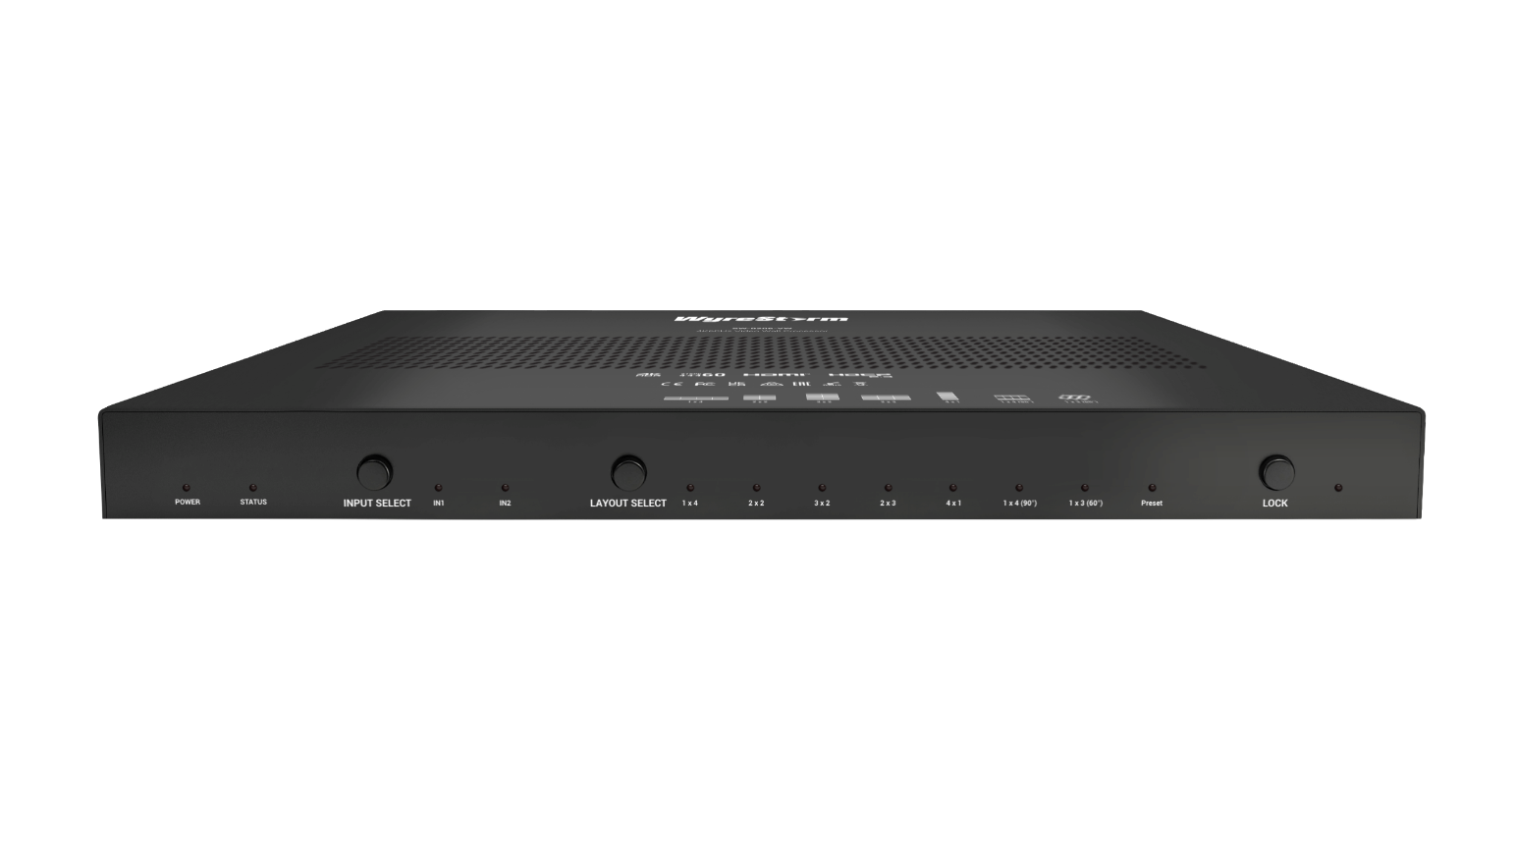


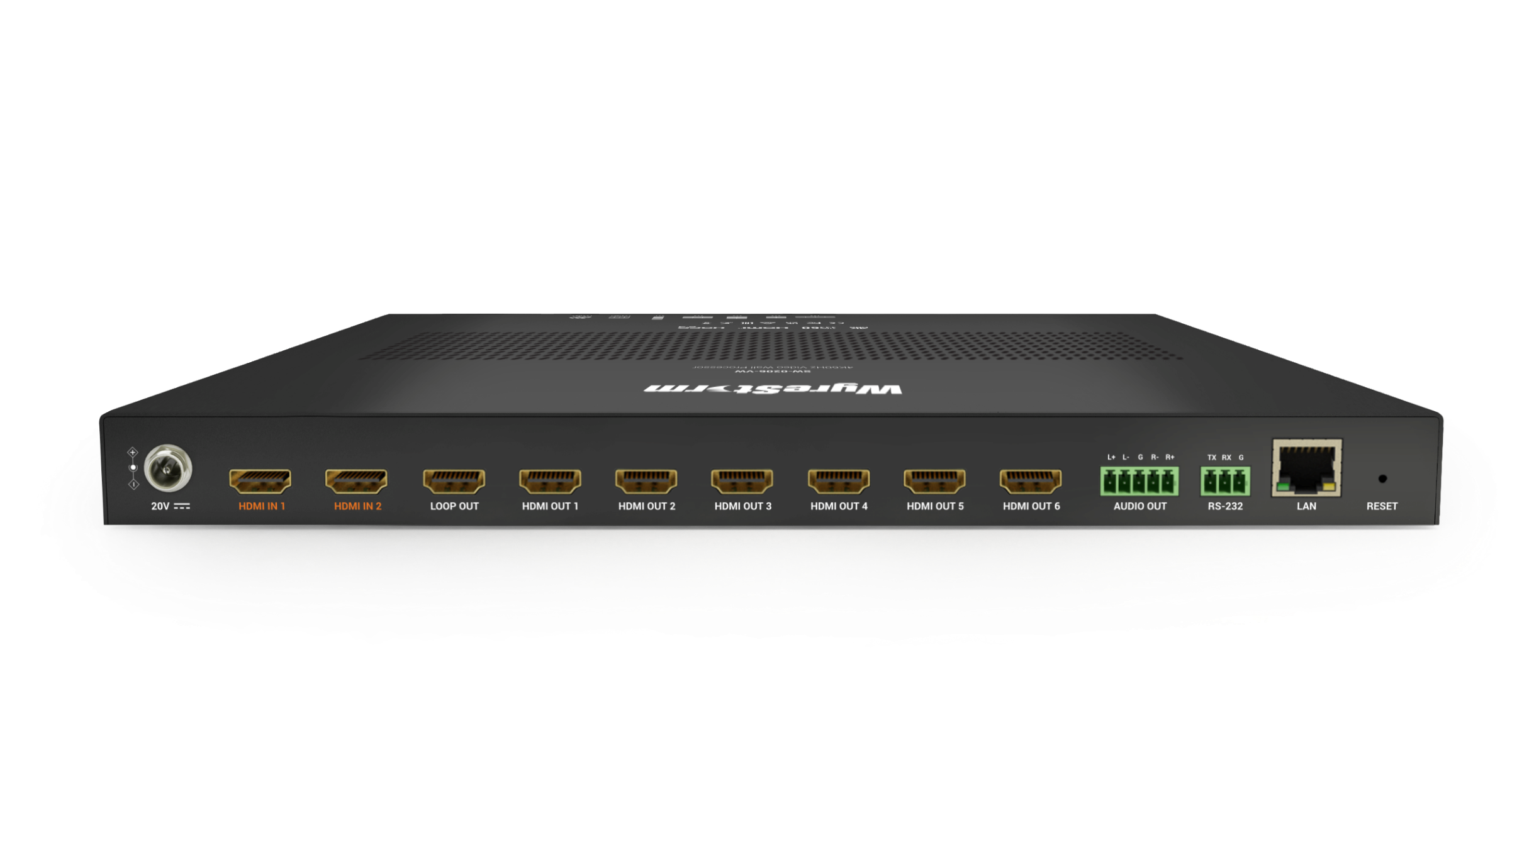

Product Brochure
SW-0206-VW
Advanced 4K Video Wall Processor
Award-Winning Audio-Visual Solutions Manufacturer
Notes:
1. 更新封面，不需要展示产品；

Slide 2


Contents
Product Overview & Key Features
Why Choose Us?
Interface & Specifications
Typical Connection & Applications
History of Previous Products
Competitor Analysis
Quick Installation Guide & Web UI Introduction
Q & A Session
Powerful · Reliable · Simple

Slide 3


Product Overview
Advanced 4K Video Wall Processor
The SW-0206-VW is a 4K@60Hz 4:4:4 Video Wall Processor designed for flexible splicing layouts, delivering an exceptional viewing experience. It supports both standard video walls and cascading multiple processors for expanding the display setup, allowing users to create customized layouts for various applications.
The cascading feature is ideal for large-scale installations, ensuring seamless synchronization across multiple screens for an immersive, unified display.
Whether for retail, exhibitions, museums, or events, the SW-0206-VW meets diverse display needs, enhancing visual impact and overall efficiency.
Powerful · Reliable · Simple

Slide 4








Main Features
Multiple Splicing Modes Supported
Includes quick layout options like 1x4, 2x2, 2x3, 3x2, 4x1, 1x4 (90°), and 1x3 (60°) for flexible and efficient screen arrangements.
Customizable Layouts:
Supports standard mxn (row x column) configurations, allowing for personalized display setups to meet various needs.
Ultra-Wide Resolution Support
Compatible with ultra-wide resolutions such as 3840x600@60Hz and 5400x1920@30Hz, perfect for expansive displays and wide-screen setups.
Cascading Video Wall
Cascading feature supports large-scale video walls, allowing configurations up to 6x6 (36 screens), ideal for control rooms, retail spaces, and events.
High-Quality Video Resolution
Provides sharp and clear visuals with support for 4K resolution at 60Hz (4K@60Hz 4:4:4), ensuring a high-definition viewing experience.
Flexible Video Rotation
Supports rotation options of 0°, 60°, 90°, 180°, and 270° to fit various display setups.
OSD & Bezel Adjustment
OSD displays IP address and HDMI output port information on-screen, while Bezel Adjustment compensates for display borders, ensuring seamless image alignment.
User-Friendly Web-UI
Simplifies control and management through an intuitive web interface, offering ease of use for both setup and ongoing operation.
Powerful · Reliable · Simple

Slide 5
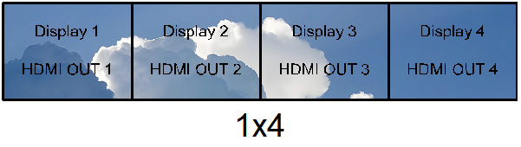
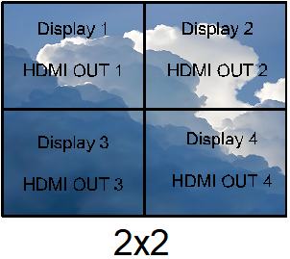
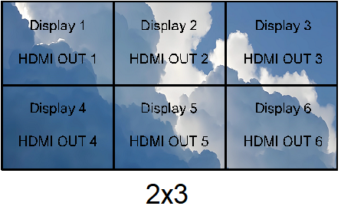
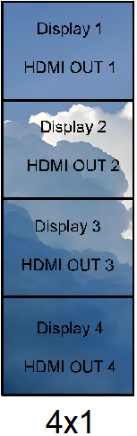
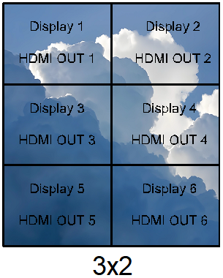
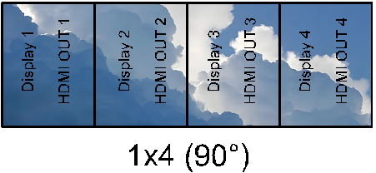
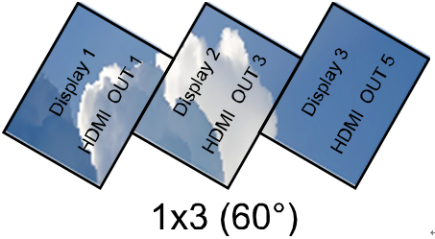
Why Choose Us: 1. Multi-Layout Video Walls & Cascading Function
Transform your display solutions with advanced splicing capabilities, delivering exceptional flexibility, seamless operation, and unmatched visual quality.
Flexible Splicing Layouts
Seamless Cascading for Large Displays
Create dynamic video walls easily with multiple splicing options, including Quick Mode and Standard Mode (m*n). Perfect for a variety of applications such as advertising, shopping malls, museums, and galleries.
Support cascading configurations up to 6x6 (36 screens), allowing you to build large-scale video walls with perfect synchronization for an impressive visual experience.
Picture Adjustment for Enhanced Viewing Productivity
Adjust the bezel and rotate the video wall (0°, 60°, 90°, 180°, 270°) for a customized display that enhances every viewing detail, ensuring clarity and precision in every scenario.
Powerful · Reliable · Simple

Slide 6
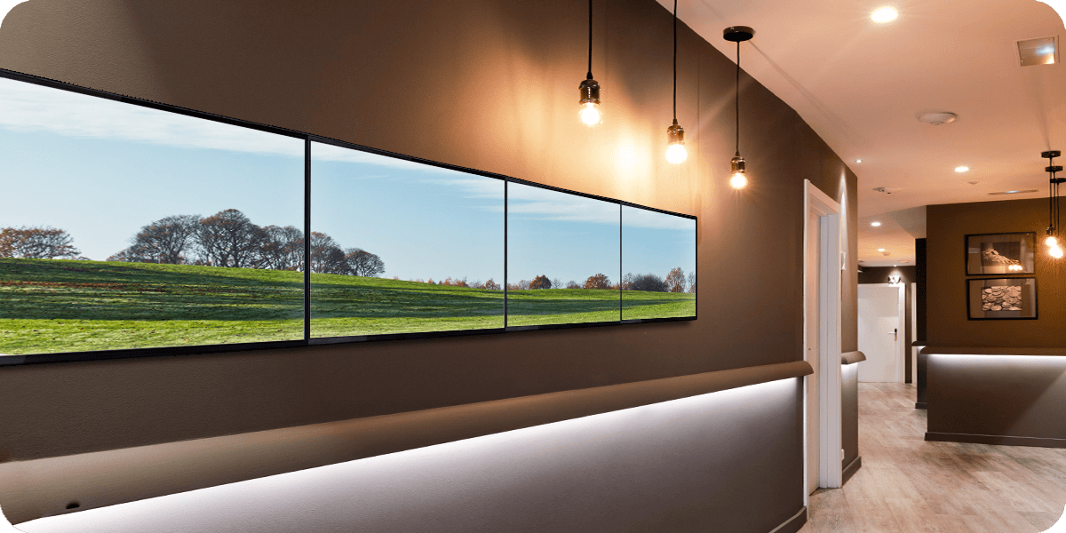
Why Choose Us: 2. High-Quality Video Performance
Enjoy superior video quality with resolutions and features designed to elevate your display experience.
Deliver High-Quality Video Performance
Support Ultra-Wide Resolutions
Achieve stunning 4K resolution at 60Hz (4K@60Hz 4:4:4), perfect for displaying detailed information on large-format screens to create a more immersive experience.
Enjoy ultra-wide resolutions, including 3840x600@60Hz and 5400x1920@30Hz, ideal for landscape-oriented video walls, making it suitable for a variety of applications.
Efficient Multi-Display Management
Easily manage and display content across multiple screens, ensuring a consistent and synchronized viewing experience across large display arrays.
Powerful · Reliable · Simple

Slide 7
Why Choose Us: 3. Easy Setup & Versatile Control
Enjoy seamless integration and effortless control, making setup and operation hassle-free for any professional environment.
Plug & Play Functionality
Control with Ease
Connect effortlessly with Plug-and-Play capability, eliminating the need for additional software or complex configurations.
Use multiple control options, including a user-friendly web interface and RS-232 for centralized control, ensuring efficient management of your video wall.
Flexible Remote Access
Manage and control your display system remotely, providing convenience and flexibility for administrators to adjust settings and monitor performance from anywhere.
Powerful · Reliable · Simple

Slide 8

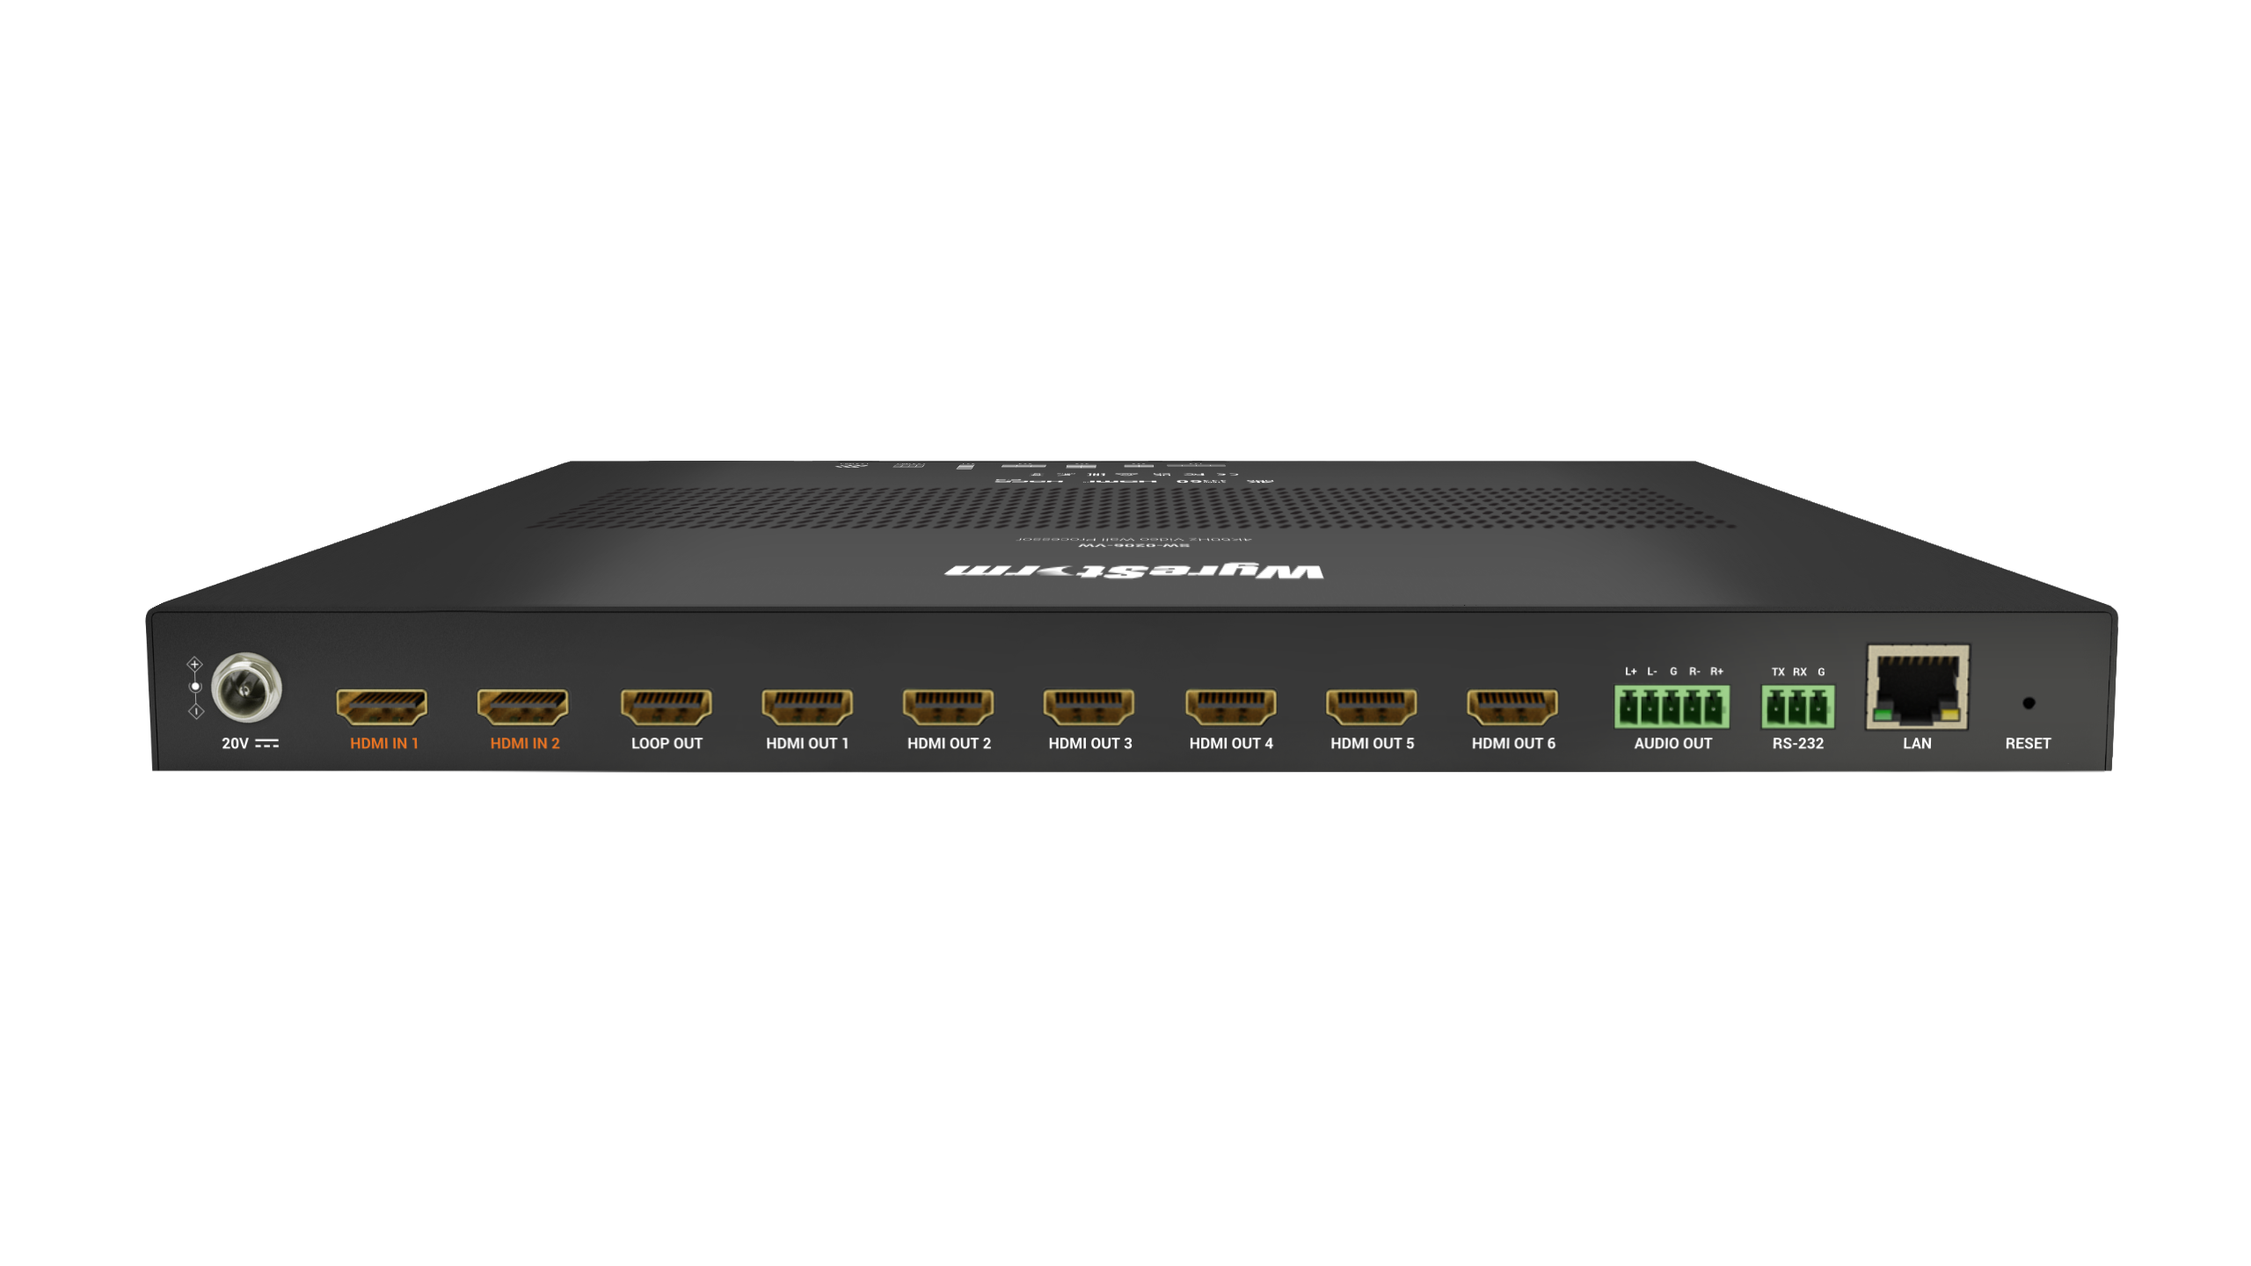
Interface of the Product
Front Panel
LAYOUT SELECT
Button
Featuring:
INPUT SELECT
Button
LOCK
Button
7 HDMI OUT Ports
Ensure seamless connection to multiple displays, including 1 loop-out port for monitoring or cascading setups.
Flexible Control
Operate effortlessly via front panel buttons, RS232, or LAN with support for Telnet API and a web-based interface.
Audio Output Options
Deliver high-quality sound with PCM 2.0 support on HDMI IN/OUT and stereo audio via the dedicated AUDIO OUT port.
Rear Panel
LOOP OUT
RS232
HDMI Inputs (1-2)
HDMI Outputs (1-6)
AUDIO OUT
LAN
Powerful · Reliable · Simple

Slide 9
Specifications & Packing List
Main Specifications
Input/Output Ports | 2 x HDMI IN, 7 x HDMI OUT (including 1 HDMI loop out port), 1 x AUDIO OUT (3.5mm phoenix connector, 5 Pins), 1 x RS232, 1 x LAN, 1 x DC 20V
Input/Output Video Type | Max: 4K@60Hz 4:4:4 8bit, HDCP 2.3
Input Resolution Supported | Wide-screen resolution: 5400x1920P⁵; 800x600⁸，1024x768⁸，1280x720P^{6,7,8}，1280x768⁸，1280x800⁸，1280x960⁸，1280x1024⁸，1360x768⁸，1366x768⁸，1440x900⁸，1600x900⁸，1600x1200⁸，1680x1050⁸，1920x1080P^{6,7,8}，1920x1200⁸，3840x2160P^{2,3,5,8}，3840x600⁸，4096x2160P^{2,3,5,8} 2 = at 24 Hz, 3 = at 25 Hz, 5 = at 30 Hz, 6 = at 50 Hz, 7 = at 59.94 Hz, 8 = 60 Hz
Output Resolution Supported | Manual: 1280x720P⁶, 1280x720P⁸，1920x1080P⁶, 1920x1080P⁸ 3840x2160P⁵, 3840x2160P⁸，4096x2160P⁵, 4096x2160P 2 = at 24 Hz, 3 = at 25 Hz, 5 = at 30 Hz, 6 = at 50 Hz, 7 = at 59.94 Hz, 8 = 60 Hz
Audio Format | HDMI IN/OUT: PCM 2.0 AUDIO OUT: Stereo
Maximum Data Rate | 18Gbps
Control Method | Front panel buttons, RS232, LAN (Telnet API & Web UI)
What’s In The Box?
1x Video Wall Processor
1x DC 20V Power Adapter
1x AC Power Cord with US Pins
1x AC Power Cord with EU Pins
1x AC Power Cord with AU Pins
1x AC Power Cord with UK Pins
1x Phoenix Male Connector (3.5mm, 3 Pins)
1x Phoenix Male Connector (3.5mm, 5 Pins)
2x Mounting Brackets (with Screws)
1x Quickstart Guide
Powerful · Reliable · Simple

Slide 10
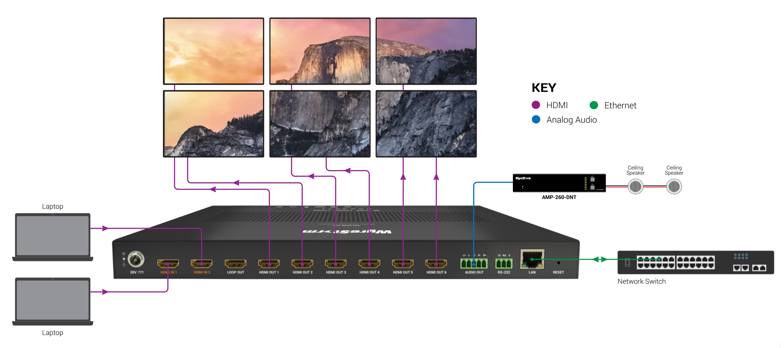
Typical Connection & Applications
Typical Connection 1:
Basic Video Wall Connection
This solution is perfect for enhancing presentation effects with a flexible 2x3 video wall setup. It ensures seamless integration of high-quality visuals and audio for an immersive experience.
2x3 Video Wall Setup: Create a stunning 2x3 video wall to elevate presentation impact.
Built-In Scaling Processor: Guarantees up to 4K@60Hz 4:4:4 outputs, even when the input video resolution is lower than 4K.
Enhanced Audio Features: Includes audio de-embedding and balanced stereo audio output to deliver superior sound quality along with the visuals.
Powerful · Reliable · Simple

Slide 11
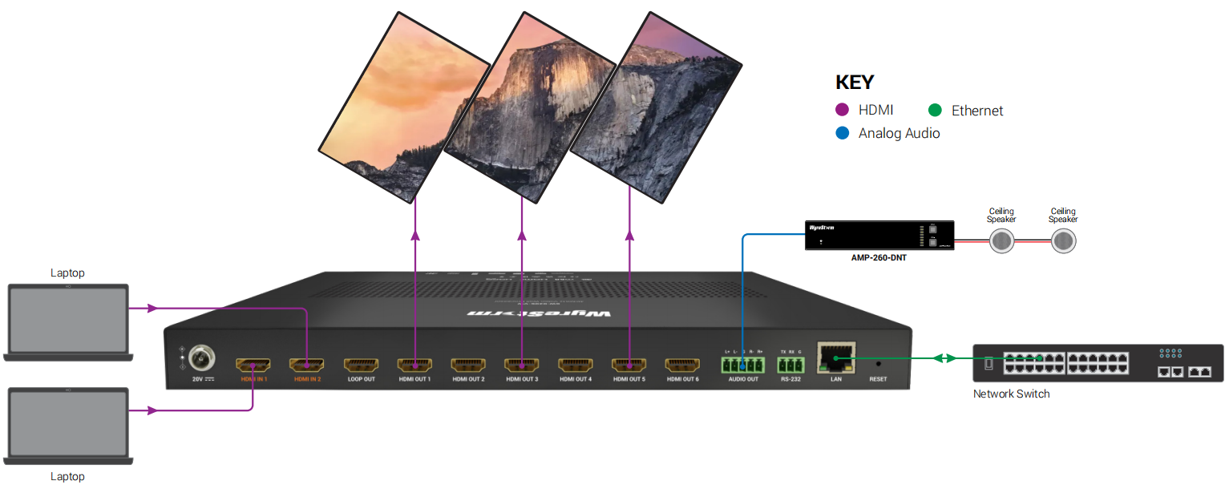
Typical Connection & Applications
Typical Connection 2:
Rotation Video Wall Connection
Creating and managing a mosaic video wall (1x3 [60°]) can attract the customer's attention immediately by providing a fully immersive experience in a variety of applications, such as shopping mall, museum or stadium.
1x3 [60°] Video Wall Setup: Create a stunning 1x3 [60°] video wall to attract the customer’s attention immediately.
Rotation Video Wall Supporting: Video rotation (0°, 90°, 180°, 270°, 60°) supporting, can be better adapted to different scene requirements.
OSD Features: OSD feature supports for each HDMI OUTPUT, helping customer to better find the relationship between screen and output, easy to installation.
Powerful · Reliable · Simple

Slide 12
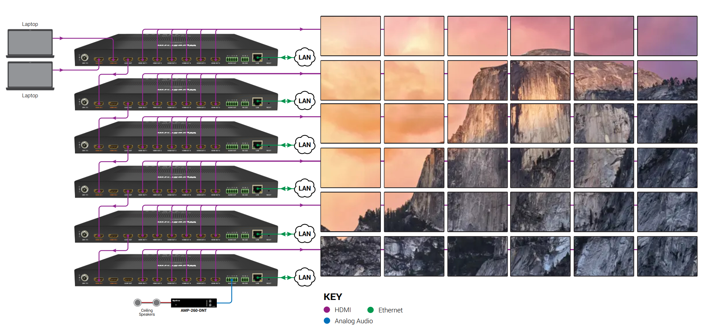
Typical Connection & Applications
Typical Connection 3:
Cascading Video Wall Connection
Ideal for large-scale setups, this cascading video wall configuration creates a stunning visual display with enhanced control for advertising and presentations.
6x6 Video Wall Setup: Create a powerful 6x6 video wall by cascading 6 devices for a large, immersive display.
High-Quality & Ultra-Wide Resolutions: Supports 4K@60Hz 4:4:4 and ultra-wide resolutions like 5400x1920@30Hz and 3840x600@60Hz, ensuring a top-tier viewing experience for your audience.
Flexible Control Options: Use the user-friendly web interface and RS232 for centralized control, providing easy management during advertising or promotional presentations.
Powerful · Reliable · Simple

Slide 13
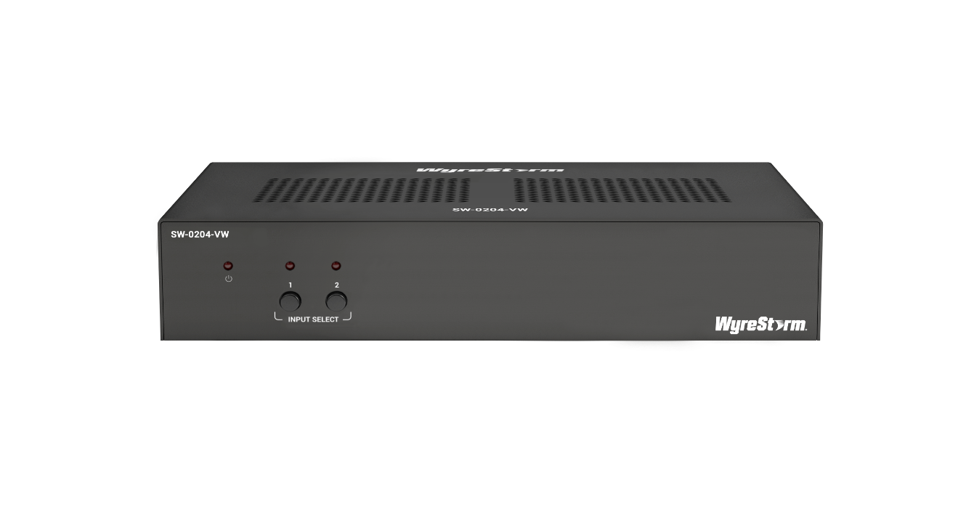

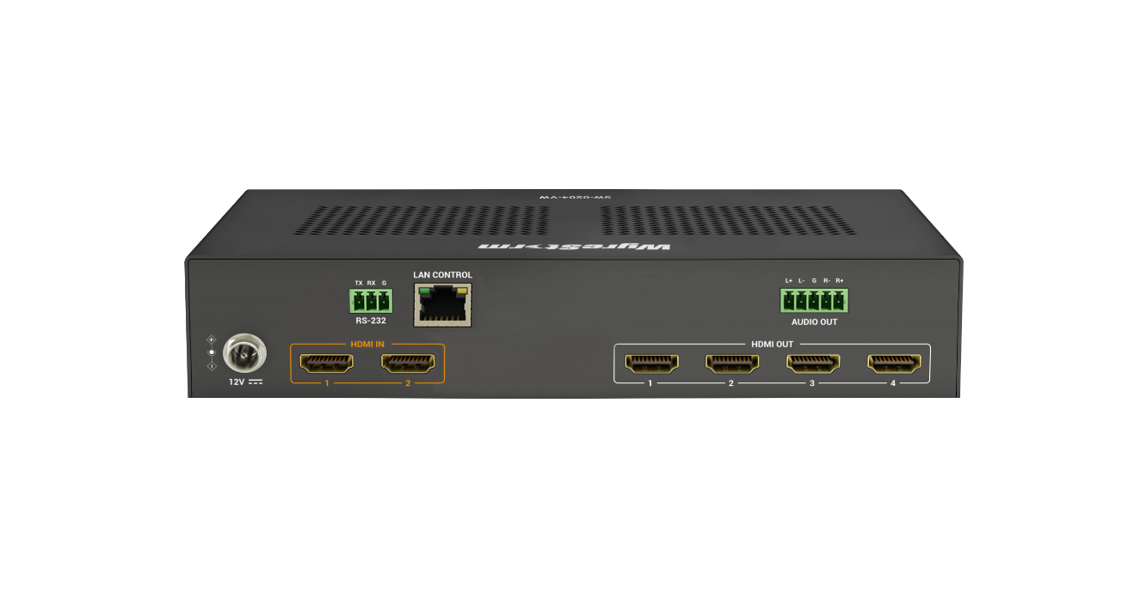
History of Previous Products
SW-0204-VW
SW-0206-VW
Selectable Video Wall Layouts: Supports configurations like 1x4 and 2x2, offering flexible row and column arrangements.
Video Wall Flip: Enables full-screen flipping for versatile display orientations.
Bezel Correction: Provides precise bezel adjustment to deliver a seamless viewing experience.
High-Quality Video Scaling: Supports up to 4K@60Hz 4:4:4 8-bit for exceptional clarity.
Ultra-Wide Resolution: Optimized for landscape orientation with a resolution of 3840x600.
Multiple Control Options: Managed via Web-UI, RS232, or Telnet for streamlined operation.
Flexible Video Wall Splicing: (1)Quick Mode: Supports layouts such as 1x4, 2x2, 2x3, 3x2, 4x1, 1x4 [90°], & 1x3 [60°]. (2)Standard Mode: Configurable as m x n layouts for customized display needs.
Cascading Feature: Seamlessly expands video walls up to 36 screens (6x6).
Video Wall Rotation: Supports multiple angles—0°, 60°, 90°, 180°, and 270°.
Bezel Correction: Delivers a seamless viewing experience with precise adjustments.
High-Quality Video Scaling: Supports resolutions up to 4K@60Hz 4:4:4 8-bit.
Ultra-Wide Resolution: Offers exceptional formats, including 3840x600@60Hz and 5400x1920@30Hz.
OSD Support: On-Screen Display settings available for each HDMI output.
User-Friendly Web-UI: Upgraded interface for streamlined control and configuration.

Slide 14
Comparison with Other Competitors
Brands |  | WyreStorm | Kramer | DATAPATH
Model |  | SW-0206-VW | VW-4 | Datapath Fx4-HDR
Video Wall | Quick Video Wall | 1x4, 2x2, 3x2, 4x1, 1x4(90°), 1x3(60°) | 2x2, 4x1, 1x4, 2x1, 3x1 | No
 | Standard Video Wall | M x N | No | Yes (M x N)
 | Mosaic Video Wall | Yes | No | Yes
 | Cascading | maximum of 6 devices cascading, video wall up to 36 (6x6) screens | maximum of 16 devices cascading, video wall up to 64 (8x8) screens | Cascading support,
 | Rotation | 0°, 60°, 90°, 180°, 270° | No | 0°, 90°, 180°, 270°
 | Bezel Adjustment | Yes | Yes | Yes
 | Preset | Yes | No | No
Video | Input | 2x HDMI Inputs | 1x HDMI Input | 3x HDMI Inputs: (2x HDMI 1.4 Inputs, 1x HDMI 2.2 Input)
 | Output | 6x HDMI Outputs 1x Loop Outputs | 1x HDMI Output 1x Loop Output | 4x HDMI Outputs 1x Loop Outputs
 | Resolution | 4K@60Hz 4:4:4 8bit Input | 4K@60Hz 4:4:4 8bit Input | 2x HDMI 1.4 Inputs 1x HDMI 2.2 Input
 |  | 4K@60Hz 4:4:4 8bit Output | HDMI outputs: 1080P | HDMI outputs: 1920 x 1200 @60Hz
 |  | 3840x600@60Hz | No | No
 |  | 5400x1920@30Hz | No | No
 | OSD | Yes | Yes | No
Audio | Audio Output | 1x 5-pin balanced analog audio output | No | 1x SYNC
Control | Panel Button | Yes | No | No
 | RS232 | Yes | Yes | No
 | LAN (Web-UI) | Yes | Yes | Yes

Slide 15
Our Advantages
This product is ideal for corporate presentations, retail displays, exhibition halls, and event rentals, offering flexible inputs, rotation settings, and wide-screen resolution support to meet diverse needs with ease.
Our Key Advantages Include:
2x HDMI Inputs & 7x HDMI Outputs: Supports multiple displays, with a loop-out port for cascading to build large-scale video walls.
Flexible Video Rotation: Supports rotation options of 0°, 60°, 90°, 180°, and 270° to fit various display setups.
Wide-Screen Resolution Support: Handles resolutions up to 5400x1920P and 4K formats at varying refresh rates for diverse presentation needs.
Flexible Control Methods: Operate via front panel buttons, RS232, or LAN with Telnet API & Web UI.
Powerful · Reliable · Simple

Slide 16

Quick Installation Guide
Effortlessly set up your video wall system with simple steps, ensuring seamless configuration and an exceptional viewing experience.
Connect Interfaces: Follow the standard product connection guidelines and customize connections based on your environment’s layout for optimal performance.
Start the Device: Use SmartGUI to locate the device's IP address, then log into the Web-UI for easy equipment configuration.
Create Your Video Wall: Choose from predefined video wall layouts or design a custom layout using the Web-UI. For detailed instructions, refer to the user manual.
Enjoy Superior Visuals: Experience stunning video clarity and immersive visuals tailored to your needs.
Powerful · Reliable · Simple

Slide 17

Important Notes for Installation
Ensure all cables are securely connected to avoid performance issues.
Check your network settings and confirm that the device is on the correct subnet.
Double-check configuration settings in the Web-UI to optimize display and functionality.
For complex installations, refer to the documentation or seek professional assistance if necessary.
Powerful · Reliable · Simple

Slide 18
Introduction of Web Configuration Interface
The Web UI of the SW-0206-VW videowall processor is designed for intuitive device management and control through any web browser. With the Web UI, you can easily configure and customize your videowall setup with the following features:
Web UI Functionality:
Interface: Effortlessly manage device settings via a web browser.
Customization: Design custom layouts and configure cascading videowalls.
Control: Set up and adjust video inputs, outputs, and EDID profiles.
Key Web UI Configurations:
General Settings: Configure IP settings, manage security, and perform firmware updates.
Videowall Settings: Choose between Quick Mode for easy setup or Standard Mode for advanced cascading videowall configurations.
Video Inputs/Outputs: Manage HDMI sources, HDCP compliance, and EDID profiles.
Control Settings: Enable RS-232 for device control and CEC for display control.
Powerful · Reliable · Simple

Slide 19

Final Thoughts
Q & A Session
Got questions? Don’t hesitate to ask away.
Powerful · Reliable · Simple

